Slide 1

Word Weaver
Team #02
Anjali Shahi, Applied Data Science (MS)
Chaitanya Kunapareddi, Applied Data Science (MS)
Kuhu Pandey, Computer Science (MS)
Sangeetha Venkatesan, Computer Science (MS)

Slide 2
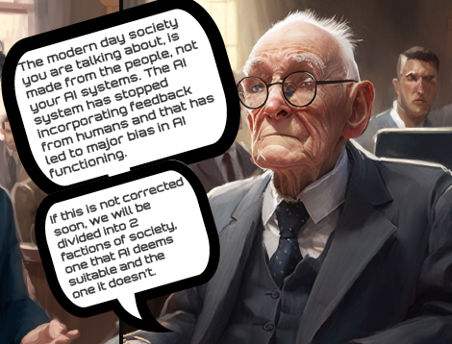
Code vs conduct
The story is set in the year 2080 when AI has integrated into all important systems in the world such as, transportation, medical facilities, banks etc.
Our main characters Moh and Maya have been on the receiving end of the biases existent in the AI system developed by a corporation called BCI Labs.
This story is about the journey of their collaboration and fight with this corporation to build a future with human intervention in AI systems.
Idea: "Justice can't be achieved alone neither by humans nor by science but by "Human-guided science"

Slide 3
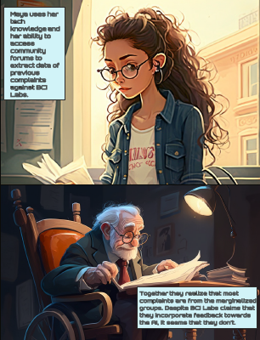
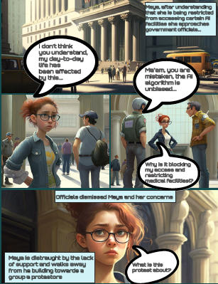
Our Imagery …

Slide 4
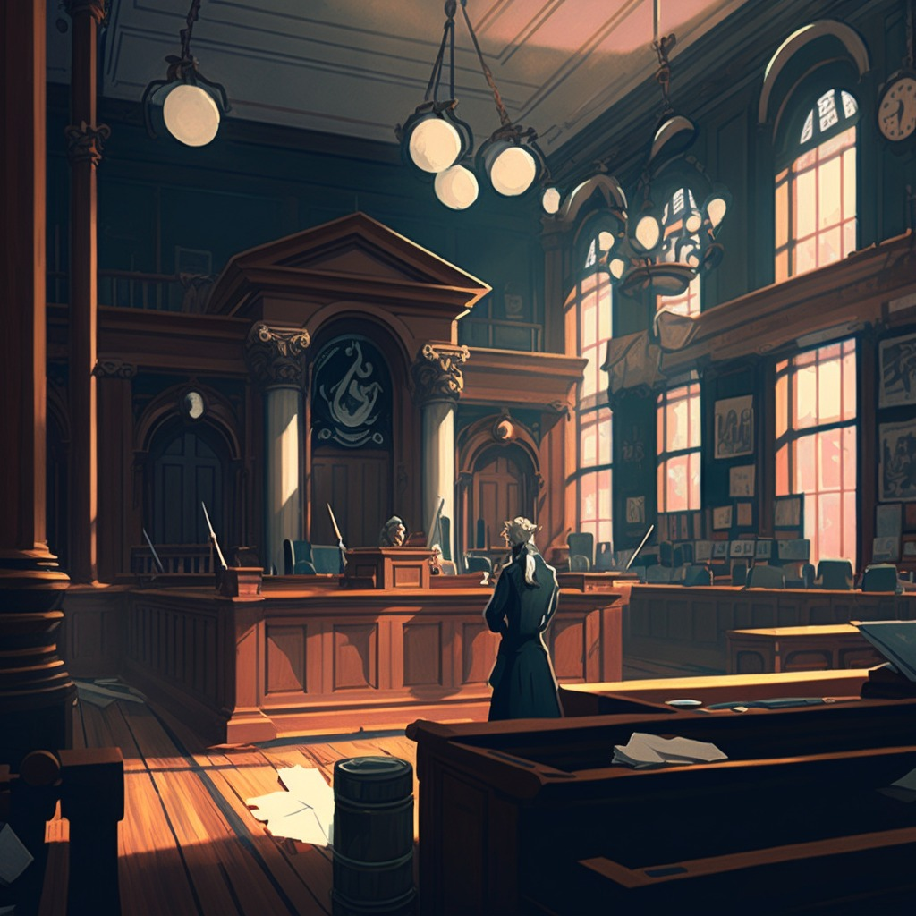
Our Technical Approach
Two main blocks:
Story for the world, impact on the reader
Components of Comics:
Themes, Dialogues, Symbolics, characters, character-environment personification
Techniques:
Verbosity and explicit narration, characteristics of person, aesthetics, balance of creativity & control.
Improving context by reference, seed, consistency in description,
Incremental addition of emotion in a scene, less room for ambiguity,
Clear intent vocabulary, clear segmentation of multicharacter scene, compare & contrast influence of keywords.
Incorporating the feedback within the team by ranking different prompts for same scene.

Slide 5
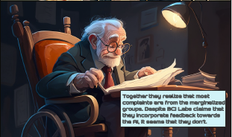
Our Theme Engagement
With the rise in the AI systems like Chat GPT, there is also concern raised on what this means for inevitable coexistence of humans and AI together.
This led to us building a story that encapsulated these concerns and hoped for a more collaborative future.

Slide 6
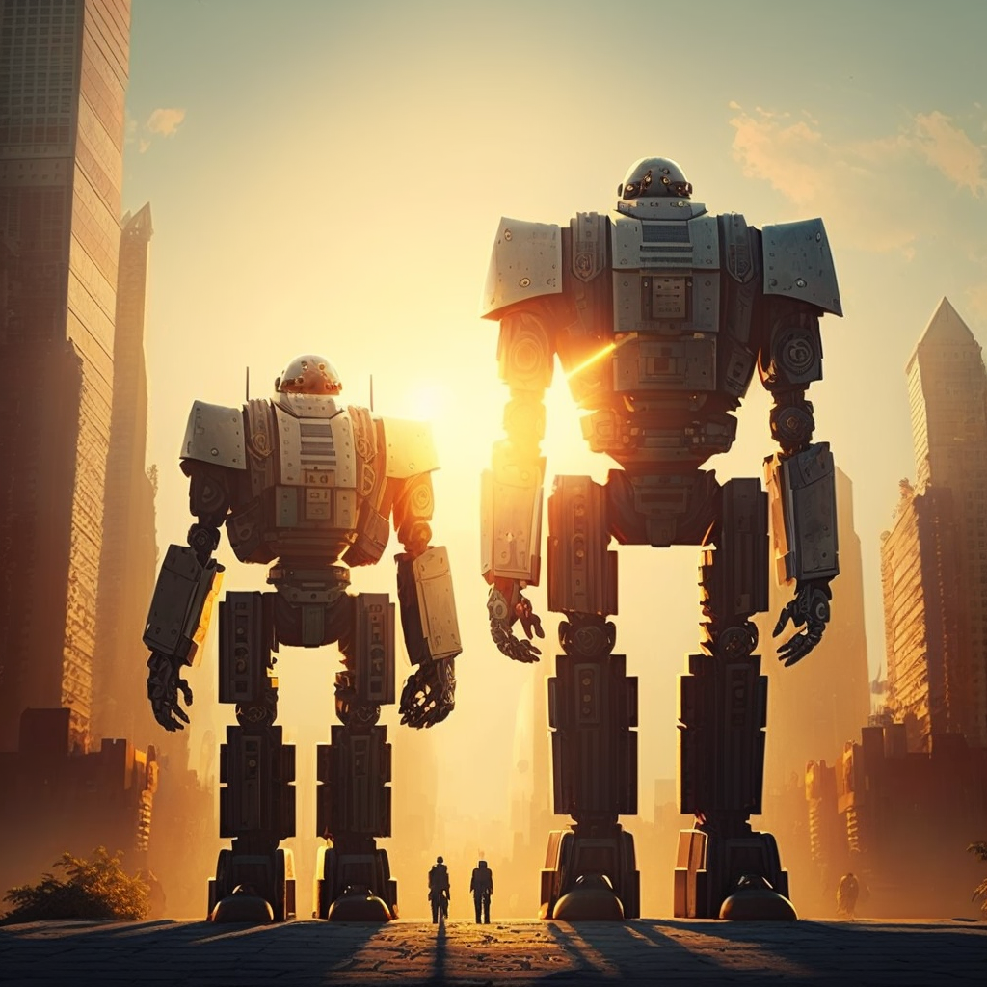




Our Big Challenge(s)
Sensitization towards keywords on how the model learnt as "AI" - representing the concept of AI without using AI keyword was the biggest challenge.
Feature representation of objects or people
Insufficient depth of semantic mapping of prompt
Long context memory is not preserved, segmentation of prompts
Explicit reasoning and verbose chain of personification
Grounding of Language model needed to represent the correct world representation

Slide 7

THANK YOU!

